Slide 1

PROJECT THEME
TEAM NAME
SOCIAL IMPACT COVID -19
R_A_M
PROJECT TITLE
TEAM MEMBERS
GO CORONA
Raghav Agarwal
Ayush Bansal
Mayur Nile

Slide 2
GO CORONA
A FLUTTER BASED ANDROID APPLICATION WHICH USES FIREBASE FOR IT’S BACKEND TO HELP SOLVE THIS SOCIAL ISSUE AROUSED IN OUR COUNTRY.

Slide 3
ABOUT
Go Corona
Project
YOUR
IDEA
This project revolves around easing the grievous state of COVID-19 by developing an app to distress the growing bulletins under one roof. This app features an idea of descriptively how people can connect through electronic media and be updated with every area through the latter. This app requests the User to input their status on being infected to the virus twice to reduce any inaccuracy. To add on to the features, the app also expands to an Admin Panel to take the correct measures at a quick response through notifications/alerts and distress numbers.
An integrated map helps to find the location of the infected person as well as help in donating groceries to the ones in need. With great versatility this app also takes a toll on any boredom due to its Chat feature. To conclude, in a pandemic like this on the cliff one can find the quintessential through this project designed.

Slide 4
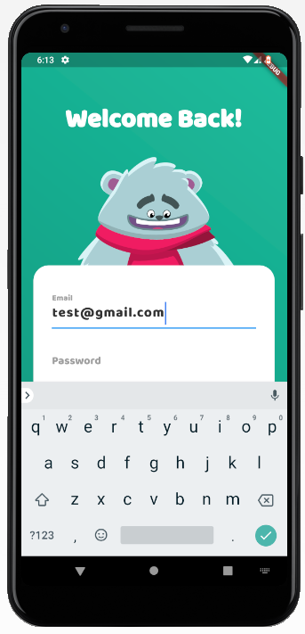
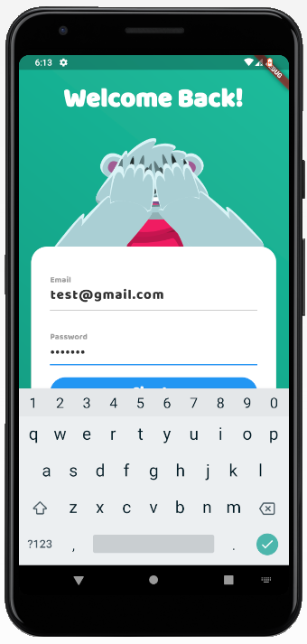
AUTHENTICATION
Interactive animated Login Screen
Email and Password based authentication
Authentication is done using Firebase

Slide 5
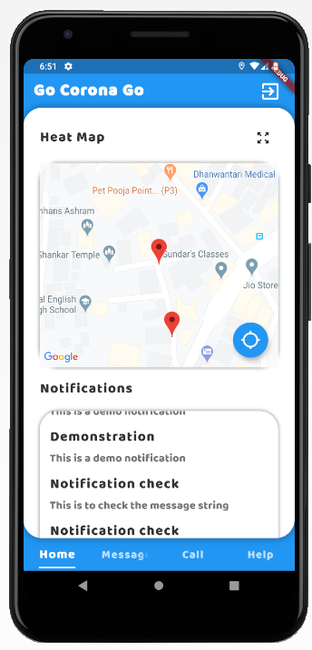
HOME PAGE
A Map section to track your and infected person’s location.
The Red Marker points to peoples location.
Only the corona infected person’s location is shown.
The marker shows live location.
Location of every user is stored in Real Time Database.
Notification section to display messages passed on by admin regarding some issues or instructions which avoids fake news or rumors to get spreaded.

Slide 6
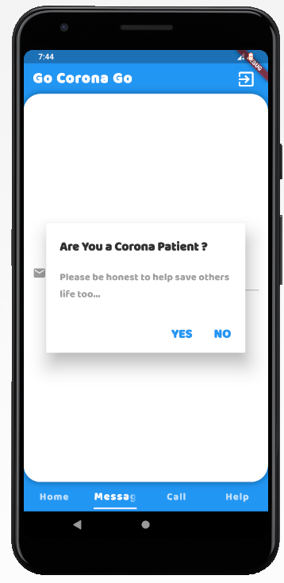
ARE YOU INFECTED?
It asks you if you are infected by Corona or not.
If you are infected by Corona then your location will be shared with users nearby you and they can track you to stay safe and distant.

Slide 7
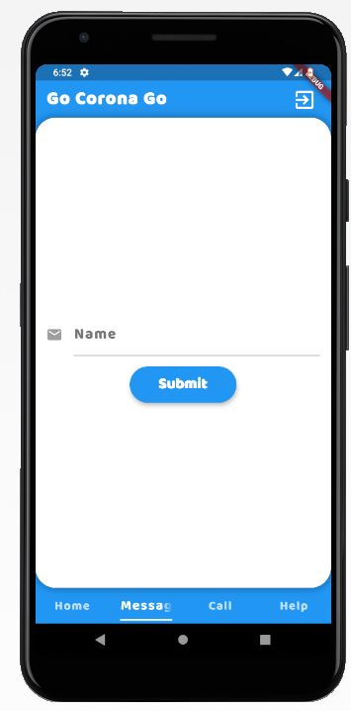
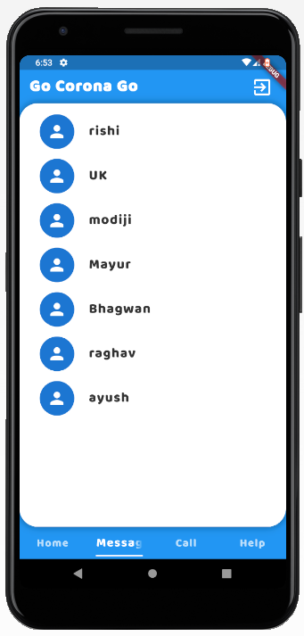
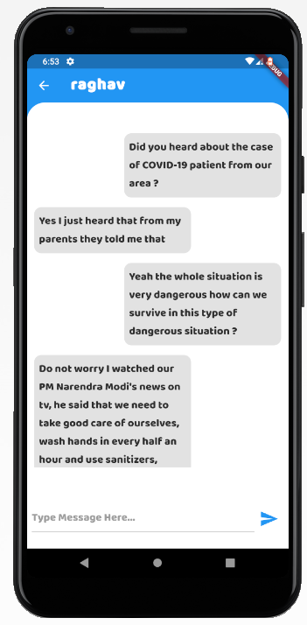
MESSAGE SCREEN
It asks you to enter your name, then you can send messages to other users.
Then you can send texts to others users and can have discussion.

Slide 8
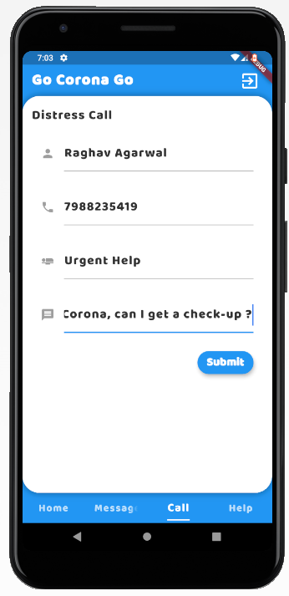
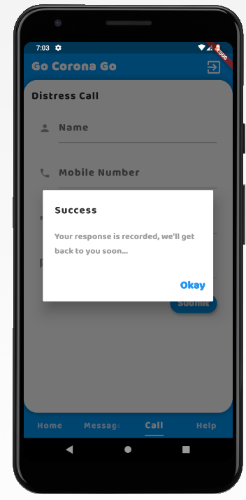
DISTRESS CALL
User can request for emergency help through this screen by just filling up the form.
This data is sent to admin panel and from there they will contact and help you out.
Some Example Use Case:
User can ask for regular checkup, Suspect a public to sanitize, Ask for checkup in case of any seen symptoms, etc.

Slide 9
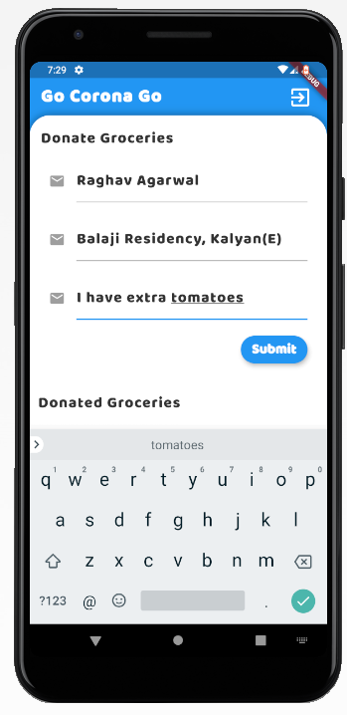
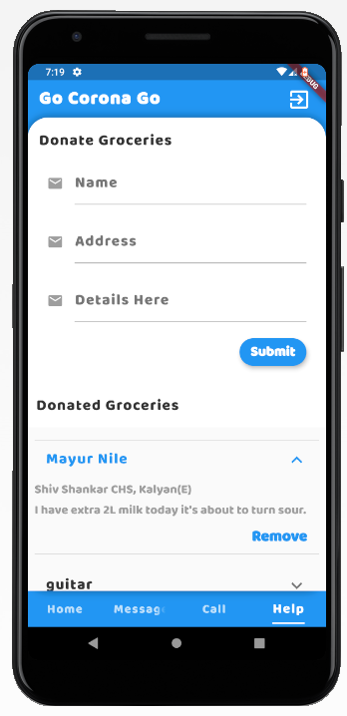
HELP SCREEN
Any user willing to donate some food/groceries, he can inform users nearby him simply filling up the form.
Then other users can check in the list and can get those items if interested.
The list is shown based on the filtered location of both the donator and receiver.

Slide 10
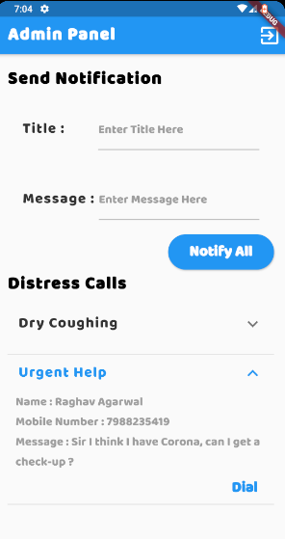
ADMIN
PANEL
The admin is the supervisor of the app
It can send notifications/alerts to all registered users of the app.
It can also see the request for the distress call.
And call can be directly dialed from the app which will redirect to default dialer.

Slide 11
FUTURE
SCOPE
Add payment gateway to help NGO’s.
Backtracking through map history to find contacts of other Corona patients.
Distributed admins based on locations.
Alert notification of any increase corona patients in users location.

Slide 12
CONCLUSION
The basic idea hence to conclude is to clear the air of tensions of this pandemic. Amidst the tension the only motto being to stay safe and sound and not inculcate the lifestyle the pandemic has given to us. Rather be productive and work towards the better.

